Slide 1

Sinai Health Practice Change: Beta-lactam Extended Infusions
Optimizing Meropenem and Piperacillin-Tazobactam Administration to Improve Patient Outcomes
Sinai Health Antimicrobial Stewardship Program

Slide 2
PK/PD data support prolonged infusions of beta-lactams
Time > MIC! The longer the drug concentration is above the MIC, the better bacterial killing effect.
Prolonging the infusion time is one way we overcome resistance, improve patient outcomes and reduce the need to escalate to broader-spectrum antibiotics.
The green line (3-hour extended infusion) keeps the drug level above the MIC (purple lines) longer than the blue line (30-minute infusion). This improves bacterial killing and is particularly important for more resistant bacteria.
MIC of a more resistant bacteria
MIC of a less resistant bacteria
Green (3hr infusion): time > MIC = 3-5 hrs
Blue (30min infusion): time > MIC = 0.5-1 hrs
Notes:
Time above the minimum inhibitory concentration (MIC) is the most important factor for effectiveness of beta-lactam antibiotics. The longer the drug concentration is above the MIC over the dosing interval, the better bactericidal killing.
With rising antimicrobial resistance, optimizing the effectiveness of antibiotics we have available in Canada has become critical. Prolonging the infusion time is one way we overcome resistance, improve patient outcomes and reduce the need to escalate to broader-spectrum antibiotics.

Slide 3

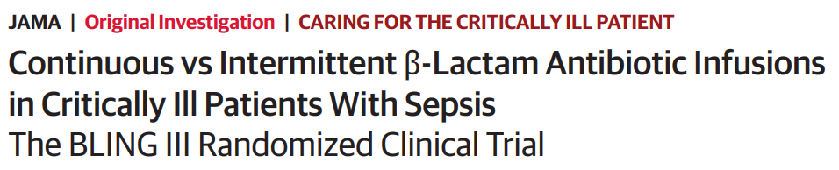
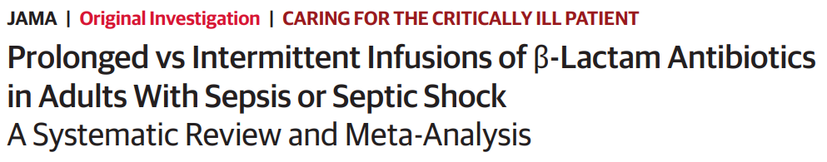
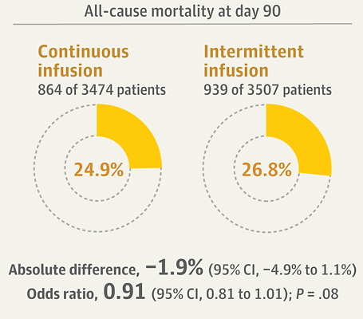
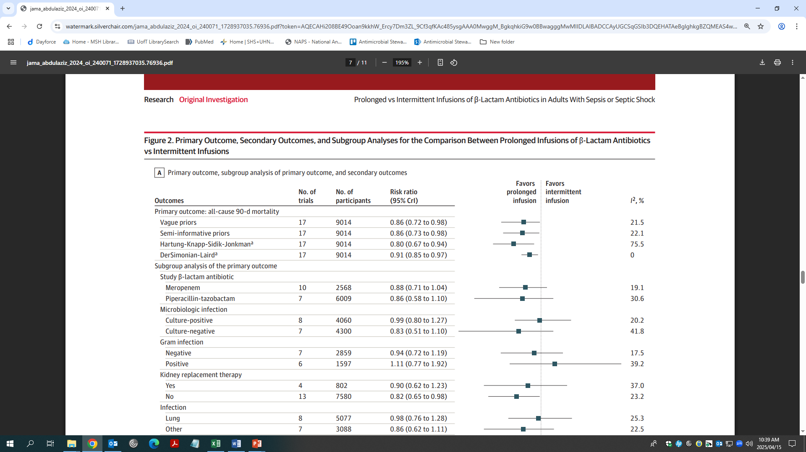
Clinical data show benefit of prolonged infusions
 | Continuous infusion | Intermittent infusion | Difference (95% CI)
Clinical Cure | 55.7% | 50.0% | 5.7% (2.4-9.1%)
Dulhunty JM, et al. JAMA. 2024;332(8):629-637. doi:10.1001/jama.2024.9779
Abdul-Aziz MH et al. JAMA. 2024;332(8):638–648. doi:10.1001/jama.2024.9803
Notes:
Lots of literature on this topic, most recently the Bling 3 trial and subsequent MA/SR demonstrating mortality benefit. Many hospitals globally have already made this change, several in GTA are making it now, and with increasing resistance we are facing we want to optimize the antibiotics we have available!

Slide 4
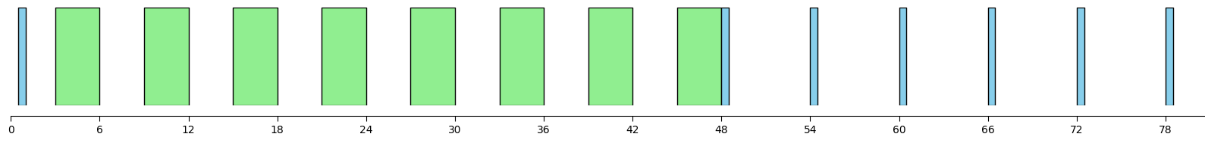
What will this look like?
The standard infusion time for meropenem and piperacillin-tazobactam for all inpatients will be 3 hours (extended infusion) instead of the traditional 30-minute infusion (usual renal dose adjustments apply)
Orders should be entered via new order sets in PowerChart which contain:
Meropenem | Piperacillin-Tazobactam
Initial dose: 1g x1 over 30 minutes Subsequent doses: 1g IV Q8H over 3 hours, starting 4 hours after initial dose (interval adjusted for CrCl) | Initial dose: 4.5g x1 over 30 minutes Subsequent doses: 4.5g IV Q6H over 3 hours, starting 3 hours after initial dose (interval adjusted for CrCl)
​
Initial dose 30m
Extended infusions 3h
Re-evaluate
Potential de-escalation
Notes:
Initially there will be a 30 min dose and then 3-4 hours after the extended infusions will begin. These will be given every 6-8 hours until 48 hours at which point there should be an re-evaluation and assessment for de-escalation

Slide 5
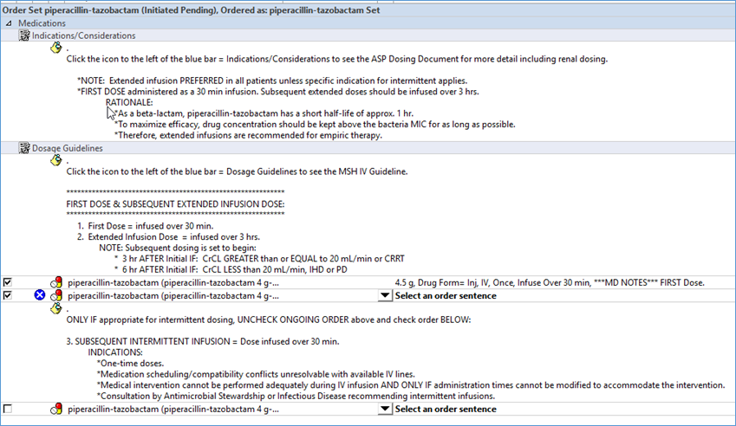
What will this look like in PowerChart?
​

Slide 6
What if patient has renal dysfunction?
Usual renal dose adjustments apply, and the infusion time does not need to be modified.
The off-set for starting the subsequent doses after the initial differs. See renal dose adjustment chart for these exceptions:
Table 1. Dosing and intervals for normal and impaired renal function for extended piperacillin/tazobactam and meropenem infusions
Drug | Dosing |  | Initial doseª | Subsequent Dose^{b}
Piperacillin/ Tazobactam | CrCl≥40 CrCl 20-39 CrCl<20 IHD PD CRRT | 4.5g q6h 4.5g q8h 4.5g q12h 4.5g q12h 4.5g q12h 4.5g q6h | Administered over 30 minutes | EI to start 3 hours after initial dose Exceptions – subsequent dose to start : 6 hours after bolus for CrCl<20, IHD, or PD
Meropenem | CrCl≥50 CrCl 25-49 CrCl 10-24 CrCl<10 IHD PD CRRT | 1g q8h 1g q12h 500mg q12h 500mg q24h 500mg q24h (AD) 500mg q24h 1g q8h | Administered over 30 minutes | EI to start 4 hours after initial dose Exceptions – subsequent dose to start : 6 hours after bolus for CrCl 10-49 12 hours after bolus for CrCl<10, IHD, or PD
ª Initial dose should administered as a 30-minute infusion regardless of the drug dosage ordered (1g vs 500mg for meropenem) ^{b} Subsequent doses should be ordered according to renal function as specified under ‘dosing’ column and administered as 3-hour infusions. The interval from initial to the first subsequent dose is specified under ‘subsequent dose’ column (interval after this first subsequent dose should be based on the ‘dosing’ column) AD, after dialysis; CrCl, creatinine clearance; IHD, intermittent hemodialysis; PD, peritoneal dialysis; CRRT, continuous renal replacement therapy
​

Slide 7
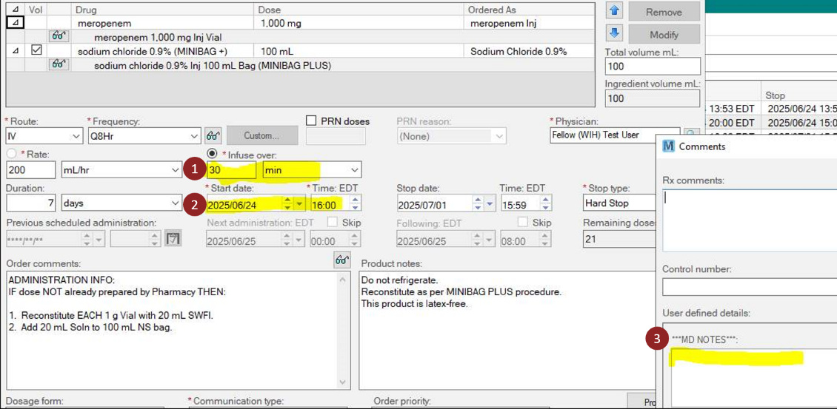
How to de-escalate therapy
Prescribers may consider shortening to 30 min infusions after 48-72hrs if appropriate for the individual patient.
  Please use our “De-escalation Guide” and flow chart on the next slide.
To shorten infusion time to 30 min, prescribers should use “Cancel/Re-order” in PowerChart.
When verifying infusion duration shortening, please ensure:
1. Infuse over changed from 3hr to 30min
2. Check timing of last dose on eMAR to ensure subsequent doses are scheduled at proper interval
3. MD NOTES comments removed

Slide 8
Does the patient still need antibiotics?
Yes
No
Can the patient be switched to oral antibiotics?
Stop antibiotics.
De-escalation Guide
Yes
No
Switch to appropriate oral antibiotic.
Can the antibiotics be changed to a narrowed spectrum?
Yes
No
Narrow antibiotics.
Is the patient clinically stable and improving?
No
Yes
Is the patient in ICU?
Yes
No
Are the patient’s infection site cultures negative ?
No
Yes
Is the targeted pathogen reporting susceptible dose-dependent (SDD) to piperacillin-tazobactam?
Yes
No
Continue extended (3 hour) infusion.
Shorten to intermittent (30 min) infusion

Slide 9
Are there any exceptions for extended infusion protocols?
One-time doses for patients in specific hospital units (e.g. OR) and in any emergent situations (including septic shock) .
Central nervous system infections requiring meropenem.
Medication scheduling and/or drug compatibility conflicts that cannot be resolved with available IV lines.
Patients with other medical interventions (e.g. PT) that cannot be performed adequately during the IV infusion AND only if administration times cannot be modified to accommodate the intervention.
Consultation by Antimicrobial Stewardship or Infectious Disease consultant recommending the use of intermittent infusion protocol.
​

Slide 10
Questions?
Sinai Health Antimicrobial Stewardship Program antimicrobialstewardship@sinaihealth.ca

Slide 11
References
Abdul-Aziz MH, Sulaiman H, Mat-Nor MB, Rai V, Wong KK, Hasan MS, Abd Rahman AN, Jamal JA, Wallis SC, Lipman J, Staatz CE, Roberts JA. Beta-Lactam Infusion in Severe Sepsis (BLISS): a prospective, two-centre, open-labelled randomised controlled trial of continuous versus intermittent beta-lactam infusion in critically ill patients with severe sepsis. Intensive Care Med. 2016 Oct;42(10):1535-1545. doi: 10.1007/s00134-015-4188-0.
Tran NN, Mynatt RP, Kaye KS, Zhao JJ, Pogue JM. Clinical Outcomes With Extended Versus Intermittent Infusion of Anti-Pseudomonal Beta-Lactams in Patients With Gram-Negative Bacteremia. Open Forum Infect Dis. 2023 Mar 27;10(4):ofad170. doi: 10.1093/ofid/ofad170.
Monti G, Bradić N, Marzaroli M, et al. Continuous vs Intermittent Meropenem Administration in Critically Ill Patients With Sepsis: The MERCY Randomized Clinical Trial. JAMA. 2023;330(2):141–151. doi:10.1001/jama.2023.10598
Dulhunty JM, Brett SJ, De Waele JJ, et al. Continuous vs Intermittent β-Lactam Antibiotic Infusions in Critically Ill Patients With Sepsis: The BLING III Randomized Clinical Trial. JAMA. Published online June 12, 2024. doi:10.1001/jama.2024.9779
Abdul-Aziz MH, Hammond NE, Brett SJ, et al. Prolonged vs Intermittent Infusions of β-Lactam Antibiotics in Adults With Sepsis or Septic Shock: A Systematic Review and Meta-Analysis. JAMA. Published online June 12, 2024. doi:10.1001/jama.2024.9803
Hong LT, Downes KJ, FakhriRavari A, et al. International consensus recommendations for the use of prolonged-infusion beta-lactam antibiotics: Endorsed by the American College of Clinical Pharmacy, British Society for Antimicrobial Chemotherapy, Cystic Fibrosis Foundation, European Society of Clinical Microbiology and Infectious Diseases, Infectious Diseases Society of America, Society of Critical Care Medicine, and Society of Infectious Diseases Pharmacists. Pharmacotherapy. 2023 Aug;43(8):740-777. doi: 10.1002/phar.2842
Wenker SA, Alabdulkarim N, Readman JB, et al. Defining the pharmacokinetic/pharmacodynamic index of piperacillin/tazobactam within a hollow-fibre infection model to determine target attainment in intensive care patients, JAC-Antimicrobial Resistance, 2024;6(2). https://doi.org/10.1093/jacamr/dlae036
Kong, D., Roberts, J.A., Lipman, J. et al. A Pooled Pharmacokinetic Analysis for Piperacillin/Tazobactam Across Different Patient Populations: From Premature Infants to the Elderly. Clin Pharmacokinet. 2025;64: 107–126. https://doi.org/10.1007/s40262-024-01460-6

